Slide 2

Overview On Apriori Machine Learning Algorithm
Sawrav Chowdhury
@sawravchy

Slide 3
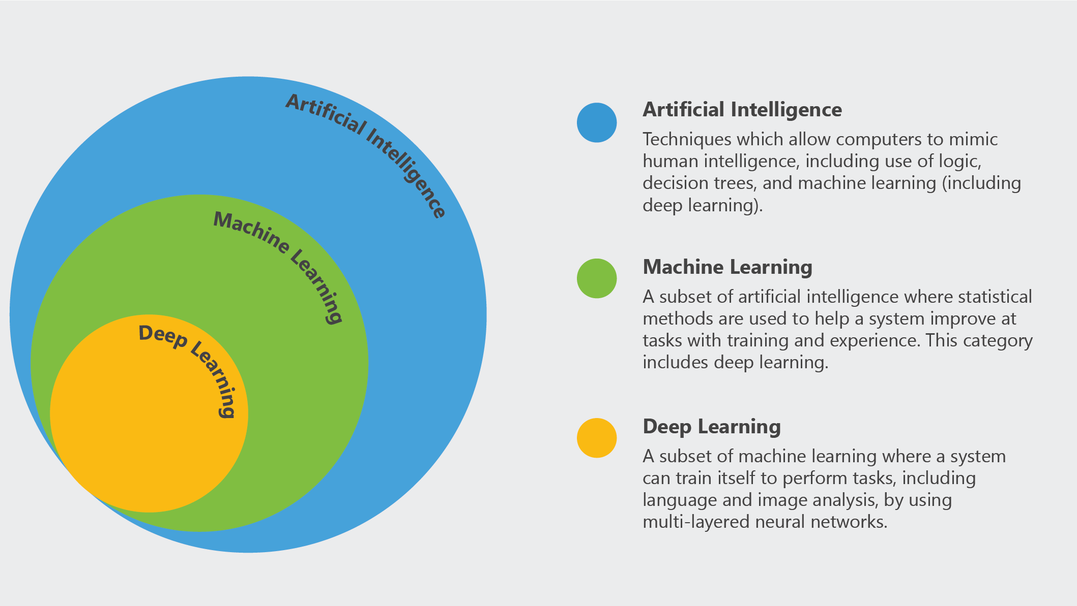
Source: Microsoft AI School

Slide 4
Apriori algorithm is an Unsupervised machine learning algorithm that generates association rules from a given data set. Association rule implies that if an item A occurs, then item B also occurs with a certain probability. Most of the association rules generated are in the IF_THEN format.

Slide 5

For example, IF people buy a Surface Book THEN they also buy a Surface Book Case to protect it. For the algorithm to derive such conclusions, it first observes the number of people who bought an Surface Book case while purchasing an Surface Book. This way a ratio is derived out of the 100 people who purchased a Surface Book, 85 people also purchased a Surface Book Case.

Slide 6
Key Concepts Of Apriori Algorithm
Frequent Item sets
The sets of item which has minimum support
Apriori Property
Any subset of frequent itemset must be frequent.
Join Operation
To find Lk, a set of candidate k-itemsets is generated by joining Lk-1with itself.

Slide 7
Applications of Apriori Algorithm

Slide 8

` Market Basket Analysis
Many e-commerce giants use Apriori to draw data insights on which products are likely to be purchased together and which are most responsive to promotion. For example, a retailer might use Apriori to predict that people who buy sugar and flour are likely to.

Slide 9
Detecting Adverse Drug Reactions
Apriori Algorithm is used for association analysis on healthcare data like-the drugs taken by patients, characteristics of each patient, adverse ill-effects patients experience, initial diagnosis, etc. This analysis produces association rules that help identify the combination of patient characteristics and medications that lead to adverse side effects of the drugs.

Slide 10
HOW APRIORI ALGORITHM WORK

Slide 11
In the Apriori Algorithm input is a transaction database and a minimum support threshold set by the user. The output is the set of frequent itemsets.

Slide 12
Step 1
Transaction | Items appearing in the transaction
T1 | Pasta,Lemon,Bread,Orange
T2 | Pasta,Lemon
T3 | Pasta,Orange,Cake
T4 | Pasta,Lemon,Orange,Cake
In step 1 algorithm is calculating database for finding support of all itemsets. Suppose here minimum support is 2
Itemsets | Support
Pasta | 4
Lemon | 3
Bread | 1
Orange | 3
Cake | 2

Slide 13
Step 2
Transaction | Items appearing in the transaction
T1 | Pasta,Lemon,Bread,Orange
T2 | Pasta,Lemon
T3 | Pasta,Orange,Cake
T4 | Pasta,Lemon,Orange,Cake
In this step we are eliminating infrequent subset
Itemsets | Support
Pasta | 4
Lemon | 3
Bread | 1
Orange | 3
Cake | 2
Itemsets | Support
Pasta | 4
Lemon | 3
Orange | 3
Cake | 2

Slide 14
Step 3
In this step Apriori algorithm will find the frequent itemsets containing 2 items. To do that, the Apriori algorithm combines each frequent itemsets of size 1 (each single item) to obtain a set of candidate itemsets of size 2 (containing 2 items).
Itemsets
Pasta, Lemon
Pasta, Orange
Pasta, Cake
Lemon, Orange
Lemon, Cake
Orange, Cake
Itemset
Pasta
Lemon
Orange
Cake

Slide 15
Step 4
Eliminates candidates of size two that have infrequent subset
Itemsets
Pasta,Lemon
Pasta,Orange
Pasta,Cake
Lemon,Orange
Lemon,Cake
Orange,Cake
Itemsets
Pasta,Lemon
Pasta,Orange
Pasta,Cake
Lemon,Orange
Lemon,Cake
Orange,Cake
(There are no infrequent subset)

Slide 16
Step 5
Transaction | Items appearing in the transaction
T1 | Pasta,Lemon,Bread,Orange
T2 | Pasta,Lemon
T3 | Pasta,Orange,Cake
T4 | Pasta,Lemon,Orange,Cake
Scan the database and calculate the support of the remaining itemset of size 2
Itemsets | Support
Pasta, Lemon | 3
Pasta, Orange | 3
Pasta, Cake | 2
Lemon, Orange | 2
Lemon, Cake | 1
Orange, Cake | 2

Slide 17
Step 6
Based on these support values,in this step the Apriori Algorithm next eliminates the infrequent candidate itemsets of size 2.
Itemsets | Support
Pasta, Lemon | 3
Pasta, Orange | 3
Pasta, Cake | 2
Lemon, Orange | 2
Lemon, Cake | 1
Orange, Cake | 2
Itemsets | Support
Pasta, Lemon | 3
Pasta, Orange | 3
Pasta, Cake | 2
Lemon, Orange | 2
Orange, Cake | 2

Slide 18
Step 8
In this step apriori algorithm eliminates candidates of size 3 having a subset of size 2 that is infrequent
Itemsets
Pasta, Lemon, Orange
Pasta, Lemon, Cake
Pasta, Orange, Cake
Lemon, Orange, Cake
Itemsets
Pasta, Lemon, Orange
Pasta, Orange, Cake
(Because {Lemon, Cake} are infrequent)

Slide 19
Step 9
In this step scan the database to calculate the exact support of the candidate itemsets of size 3, to check if they are really frequent.
Itemsets | Support
Pasta, Lemon, Orange | 2
Pasta, Orange, Cake | 2

Slide 20
Step 10
In this step algorithm next eliminates the infrequent candidate itemsets of size 3 o obtain the frequent itemset of size 3.
Itemsets | Support
Pasta, Lemon, Orange | 2
Pasta, Orange, Cake | 2
Itemsets | Support
Pasta, Lemon, Orange | 2
Pasta, Orange, Cake | 2
(There are no infrequent subset)​

Slide 21
Step 11
Apriori algorithm will try to generate candidate itemsets of size 4. This is done by combining pairs of frequent itemsets of size 3.
Itemsets
Pasta, Lemon, Orange
Pasta, Orange, Cake
Itemsets
Pasta, Lemon, Orange, Cake

Slide 22
Step 12
In this step algorithm eliminates Itemset of size 4 having a subset of size 3 that is infrequent.
Itemsets
Pasta, Lemon, Orange, Cake

Slide 23
Final Itemset Result
Itemset | Support
Pasta | 4
Lemon | 3
Orange | 3
Cake | 2
Pasta, Lemon | 3
Pasta, Orange | 3
Pasta, Cake | 2
Lemon, Orange | 2
Orange, Cake | 2
Pasta, Lemon, Orange | 2
Pasta, Orange, Cake | 2

Slide 24
Advantages of Apriori Algorithm
It is easy to implement and can be parallelized easily.
Apriori implementation makes use of large item set properties.

